Slide 1
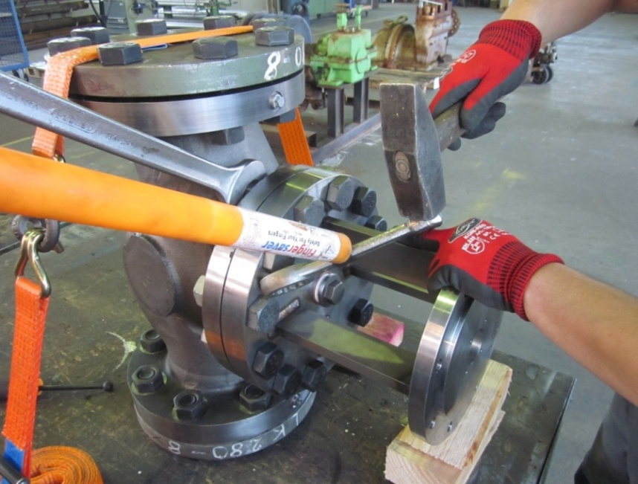
HS&E INCIDENT BULLETIN |  | 2nd half year 2014
Germany | Type of incident - Line of Fire
Summary:
During bolting of a screw at a connection component using a bump key and hammer, the bump key slipped from the nut and hit one of the employee’s left middle fingers while he was using the hammer. The injured employee was taken immediately to the hospital for further examination where he was diagnosed with a broken middle finger.
Root Causes: | Actions Taken Thus Far: Next Steps
False sense of security when using finger saver tool. | Reinforce keeping hands out of line of fire, study possibility of another method using different tool

